Slide 1
Transmit Focusing and PSF
BME 844:
HW1 and HW2

Slide 2
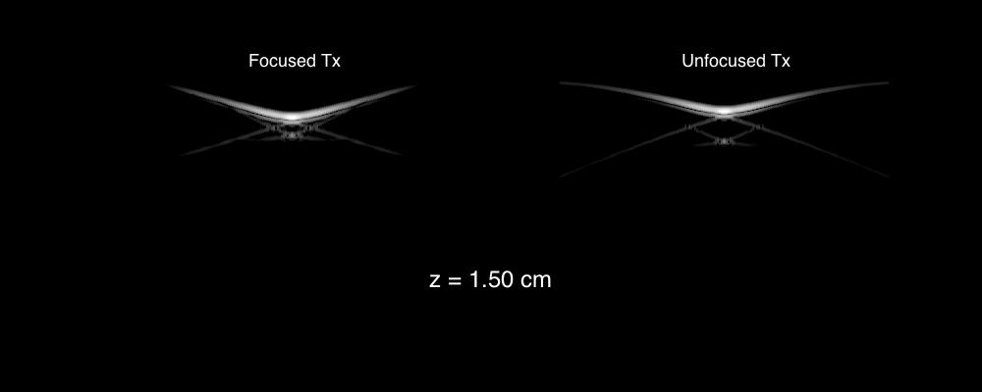
Propagating PSF

Slide 3
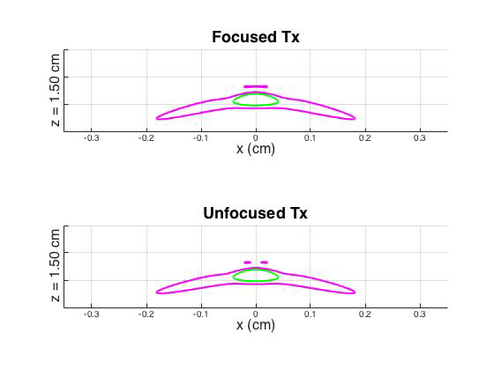
6 dB and 12 dB Contours

Slide 4
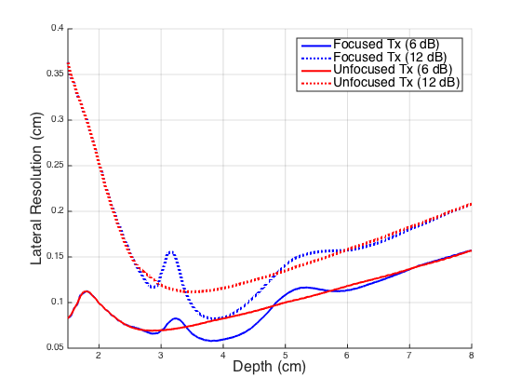
Lateral Resolution vs Depth

Slide 5
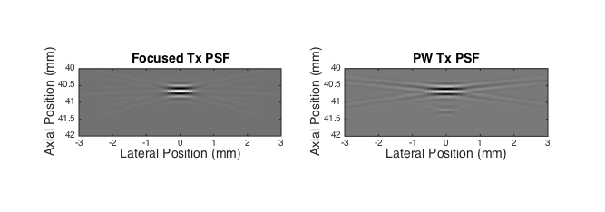
Focal PSF
High axial frequency in both cases
Tighter PSF in focused PSF (more lateral frequency content, higher frequencies)

Slide 6
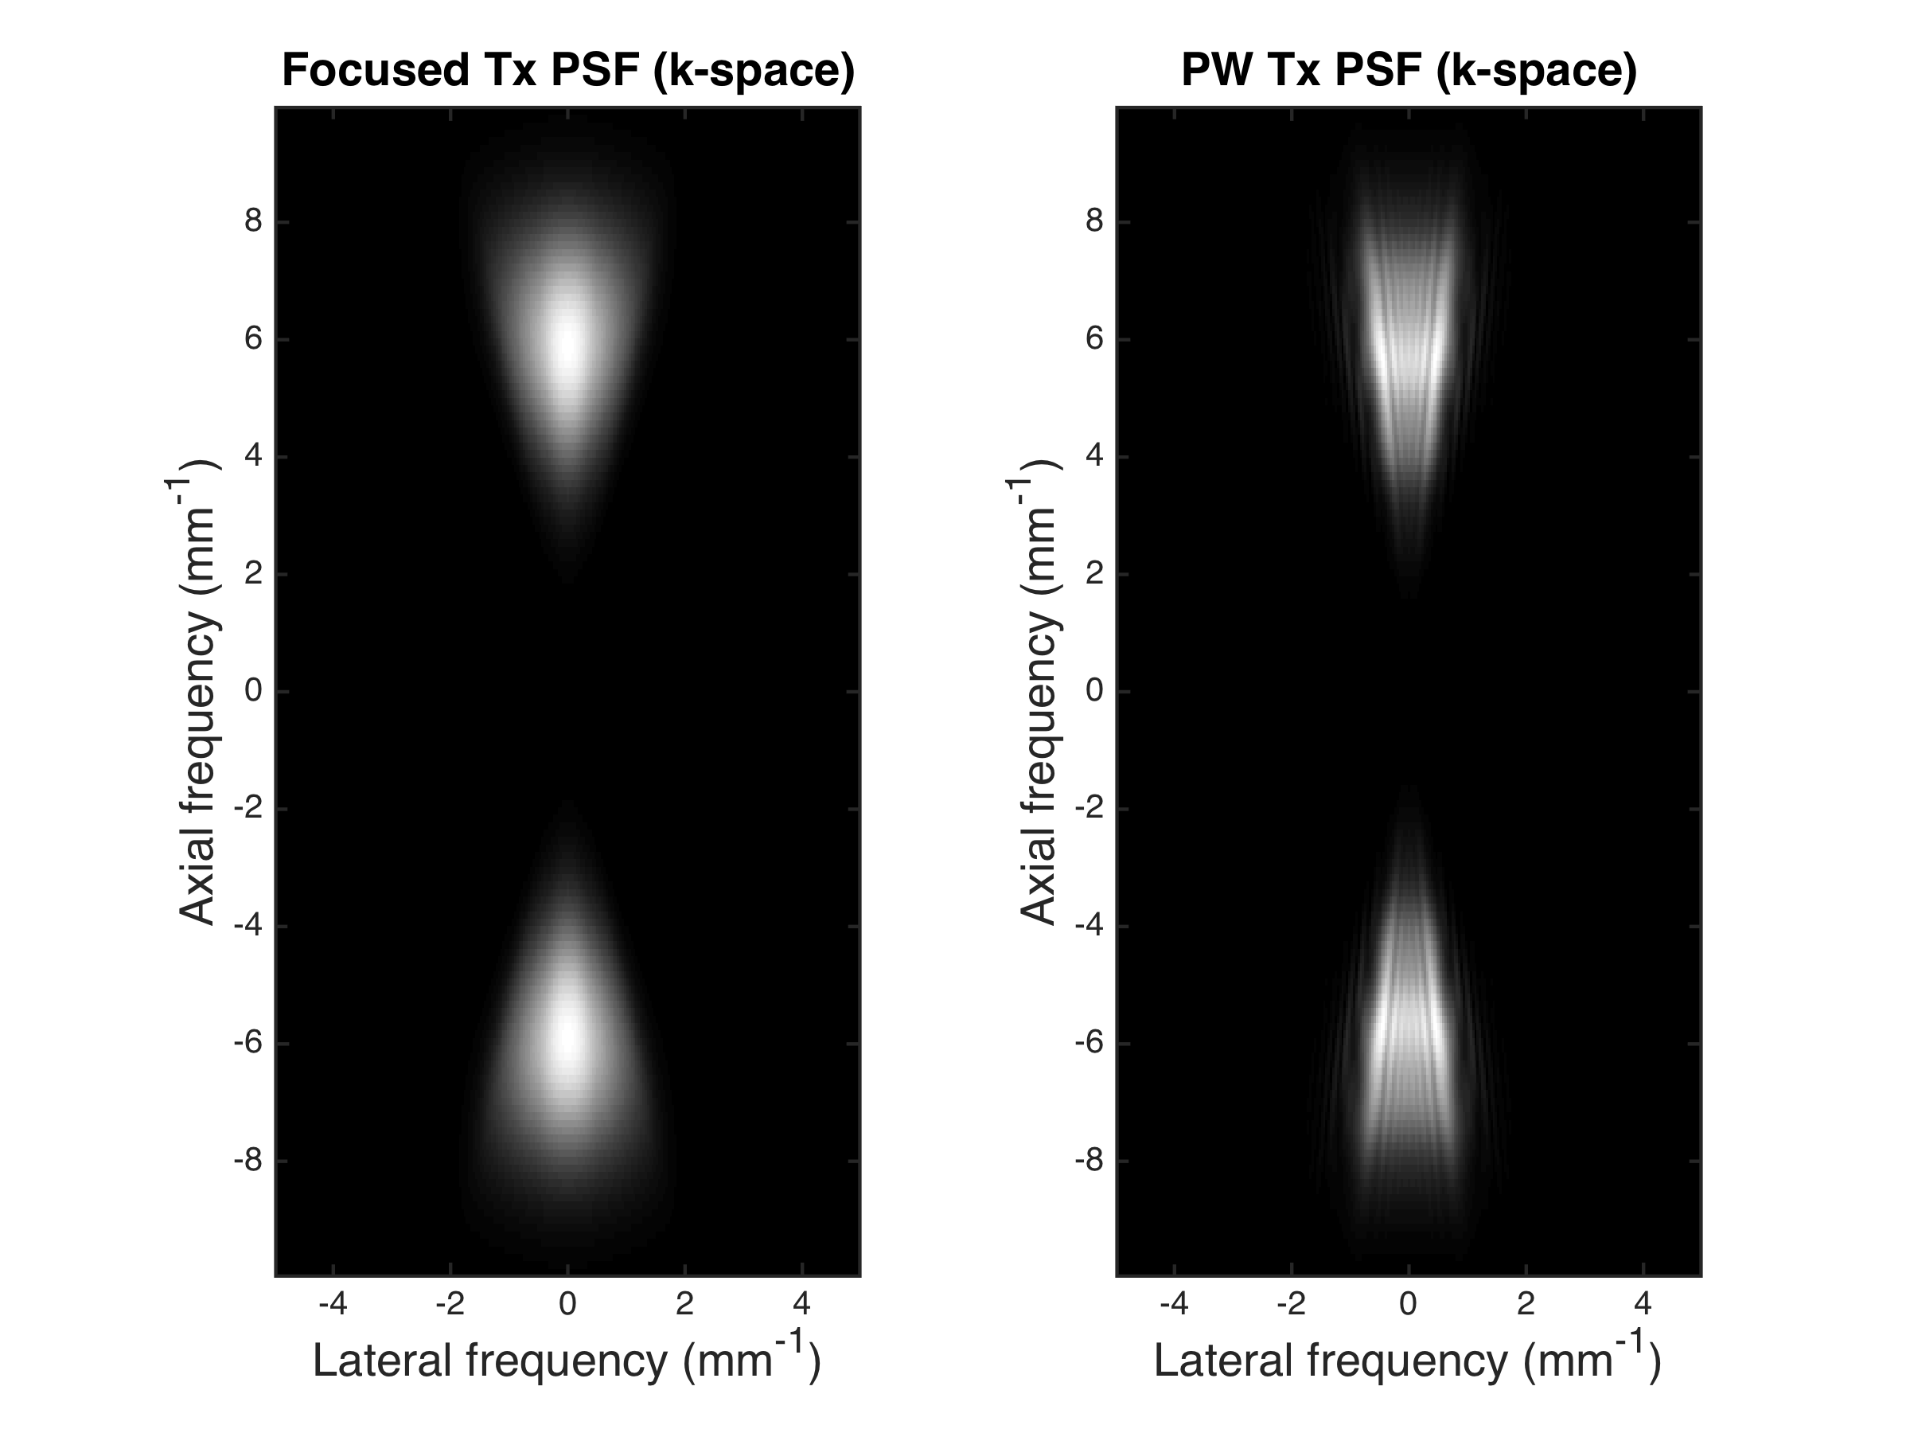
K-space of focal PSF
Notes:
Horizontal streaks from pw result in low frequency in lateral k (parallel with lateral direction) and high frequency streaks in axial k (perpendicular with axial)

Slide 7
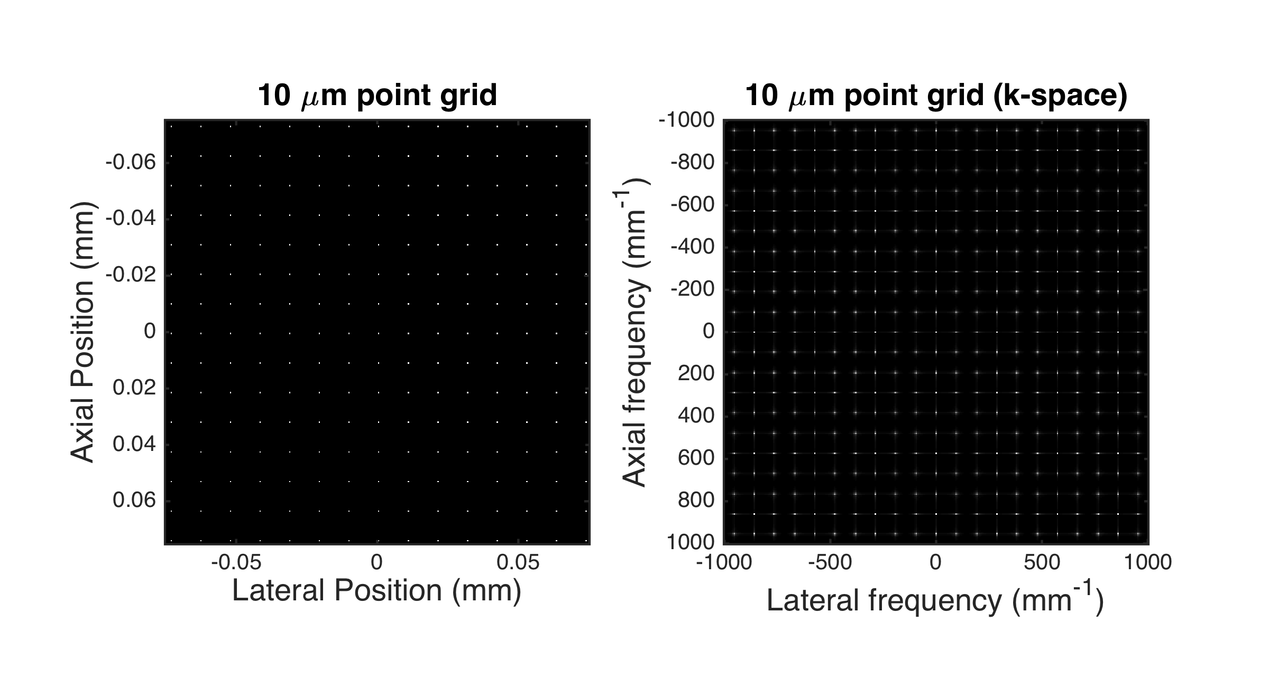
Scatterers with 10 μm spacing
Notes:
100 mm-1 spacing = 1/10um

Slide 8
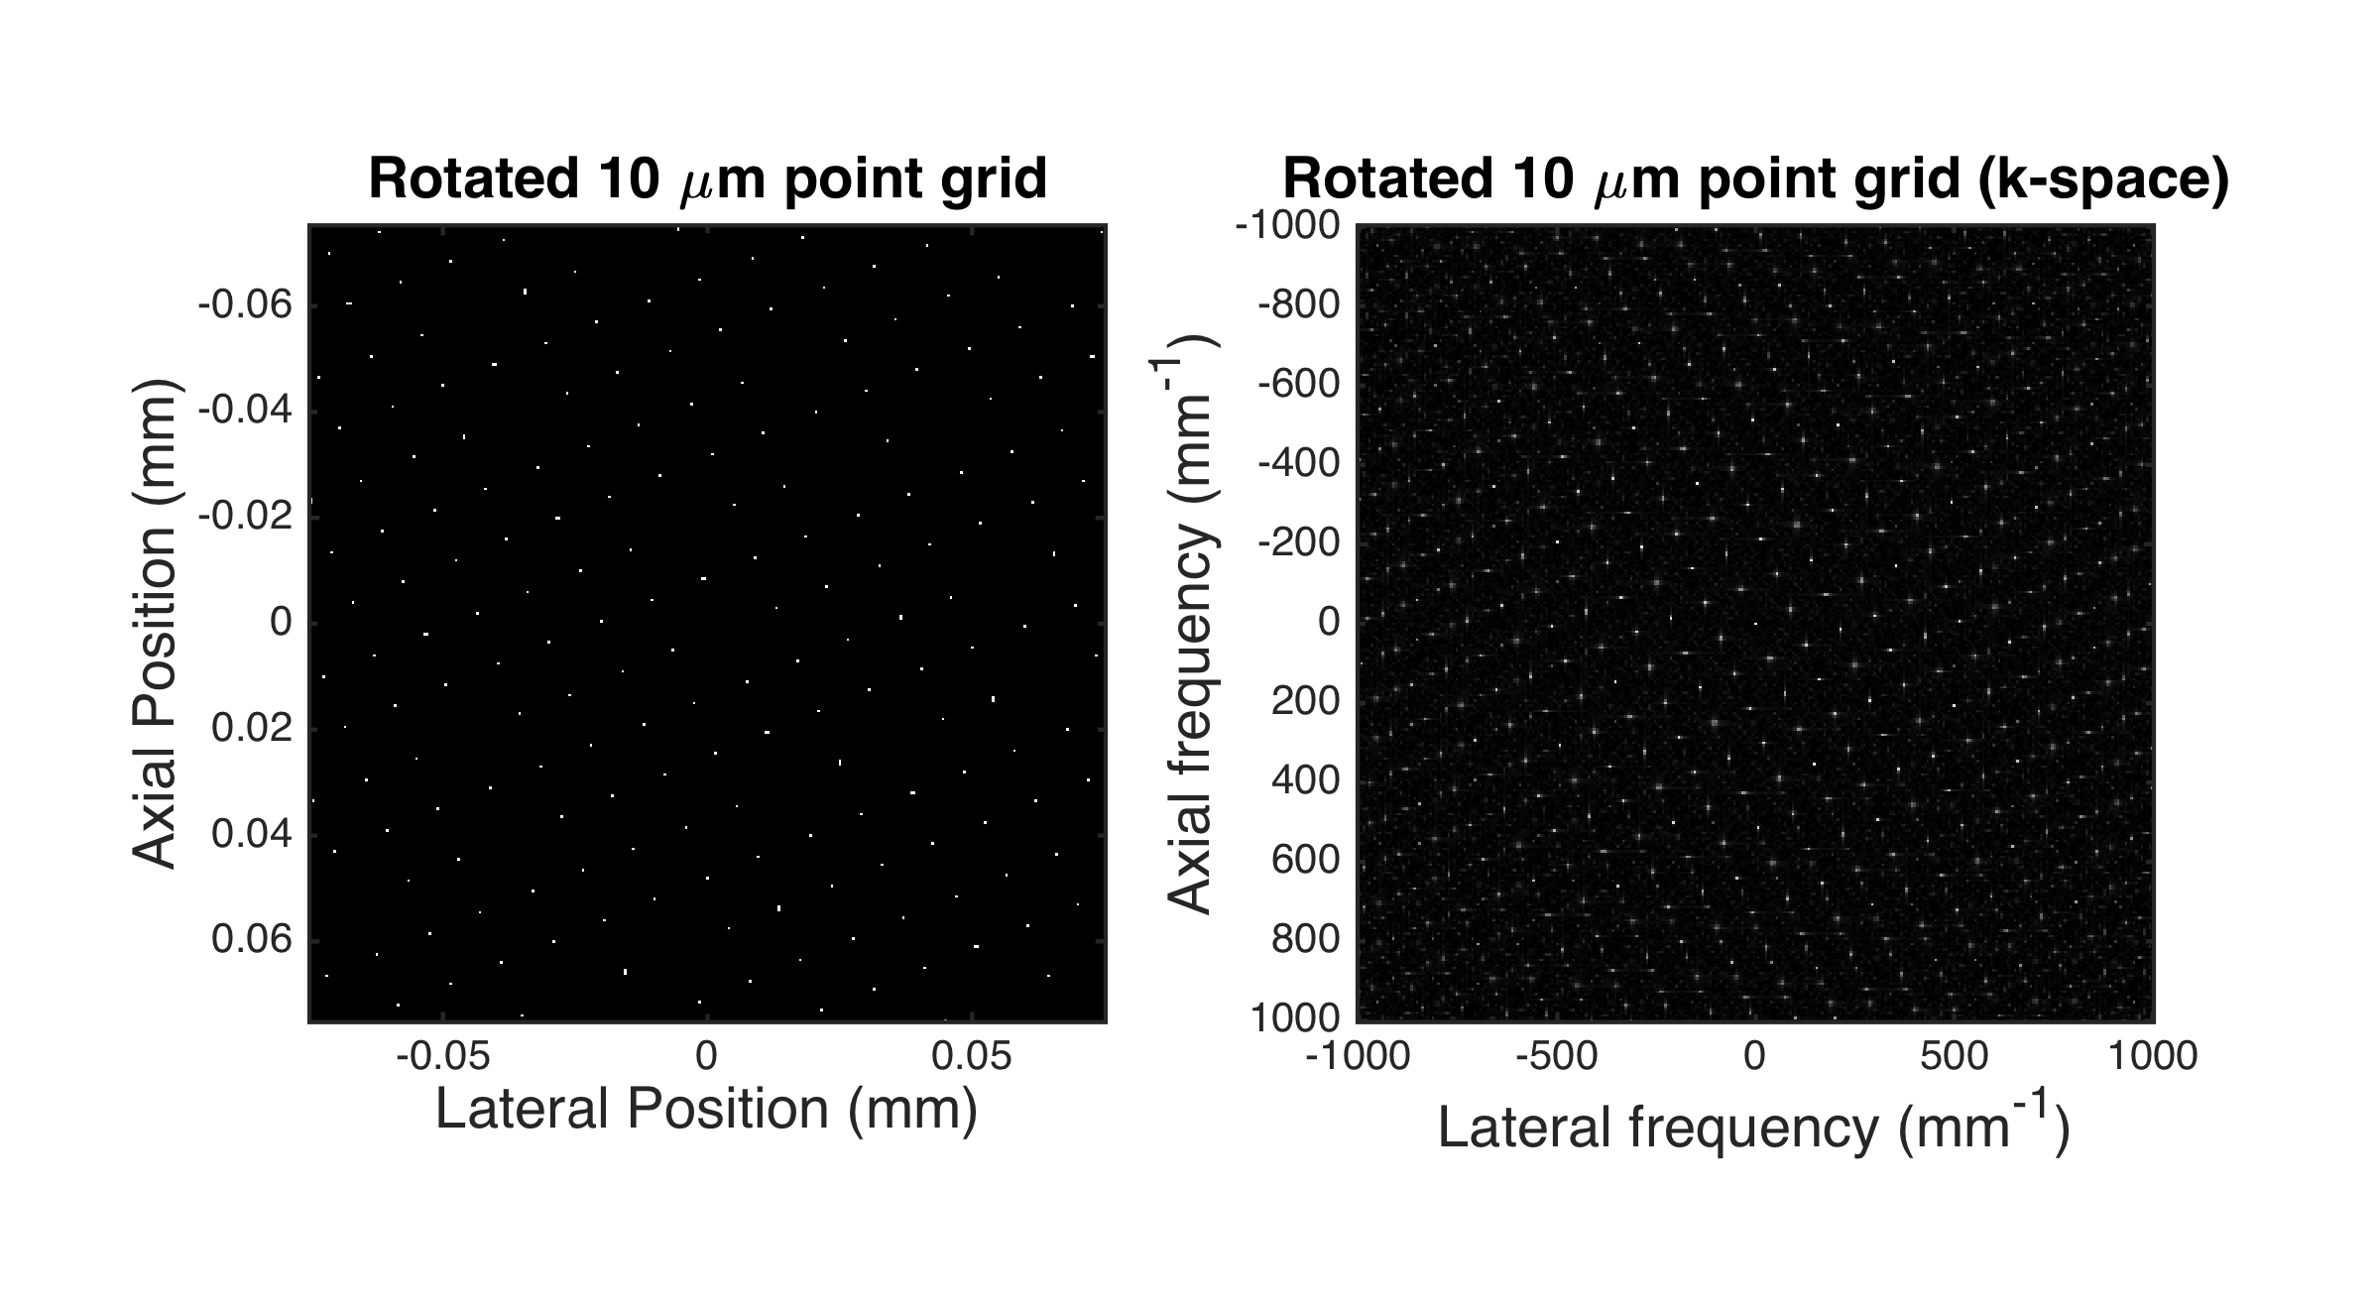
Scatterers with 10 μm spacing (rotated)

Slide 9
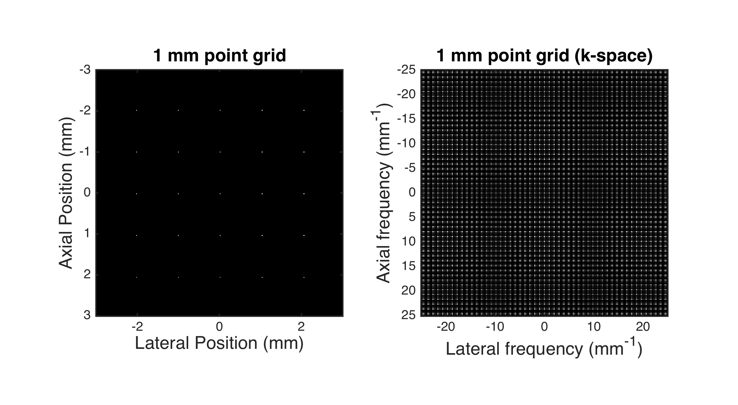
Scatterers with 1 mm spacing
Notes:
1 mm-1 spacing = 1/1mm

Slide 10
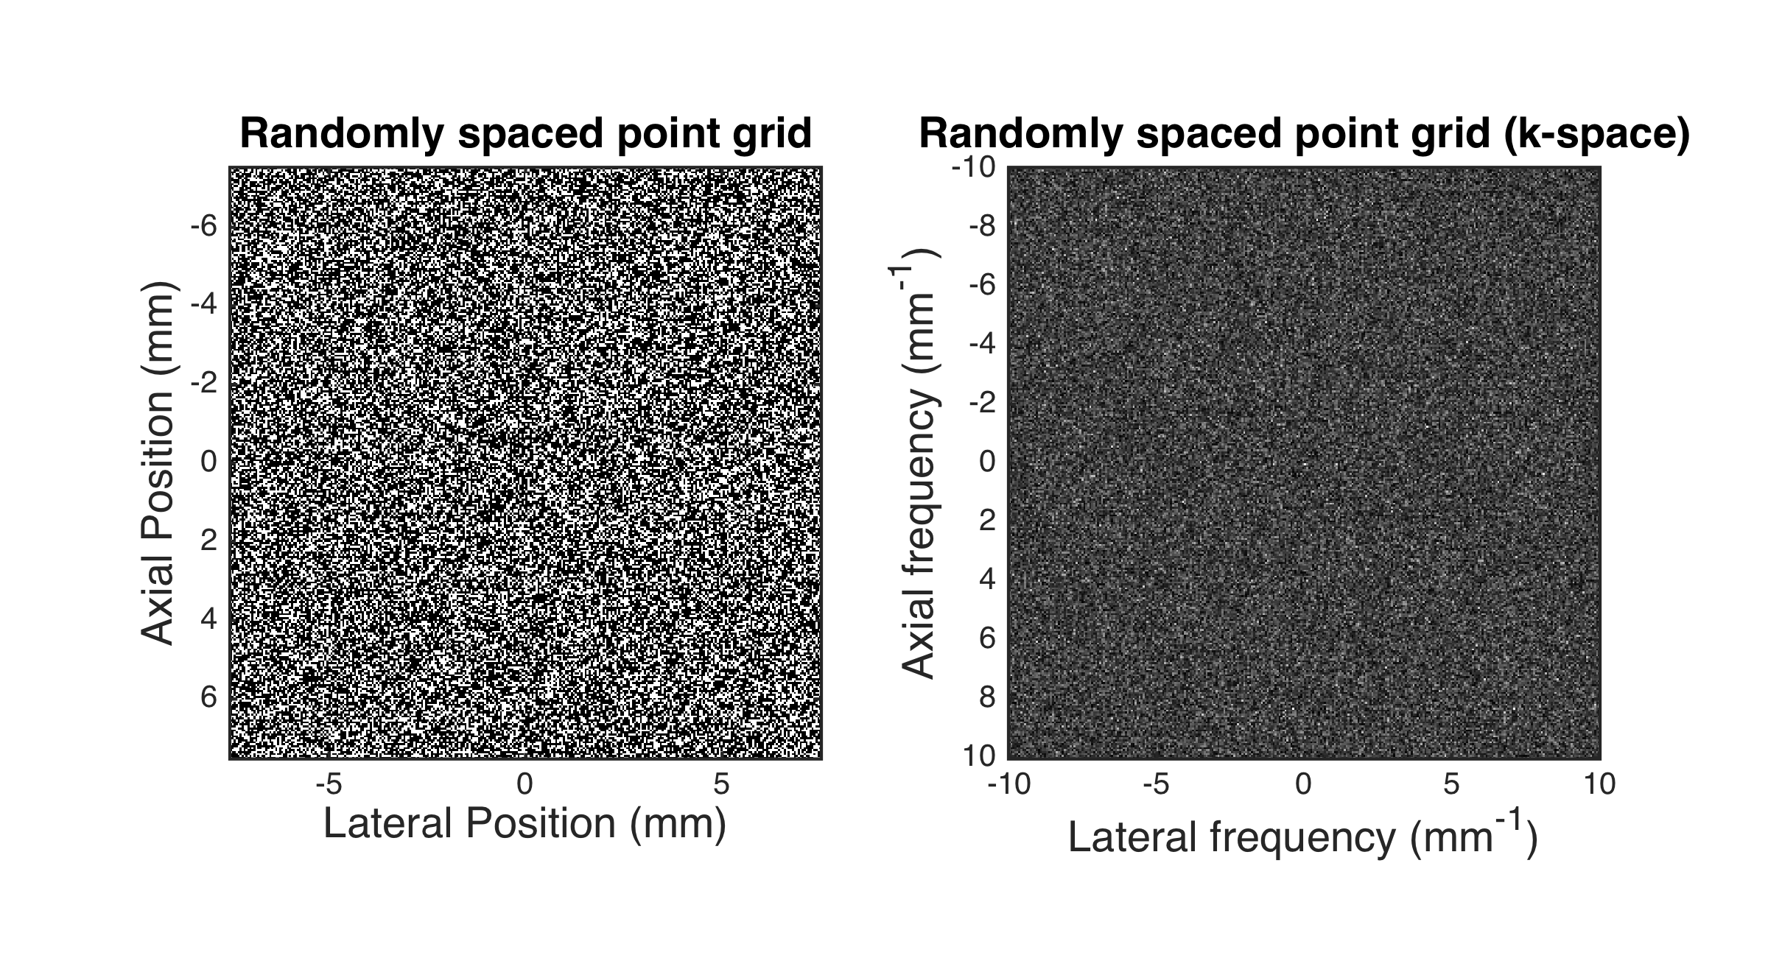
Scatterers with random spacing
Notes:
White noise = white noise

Slide 11
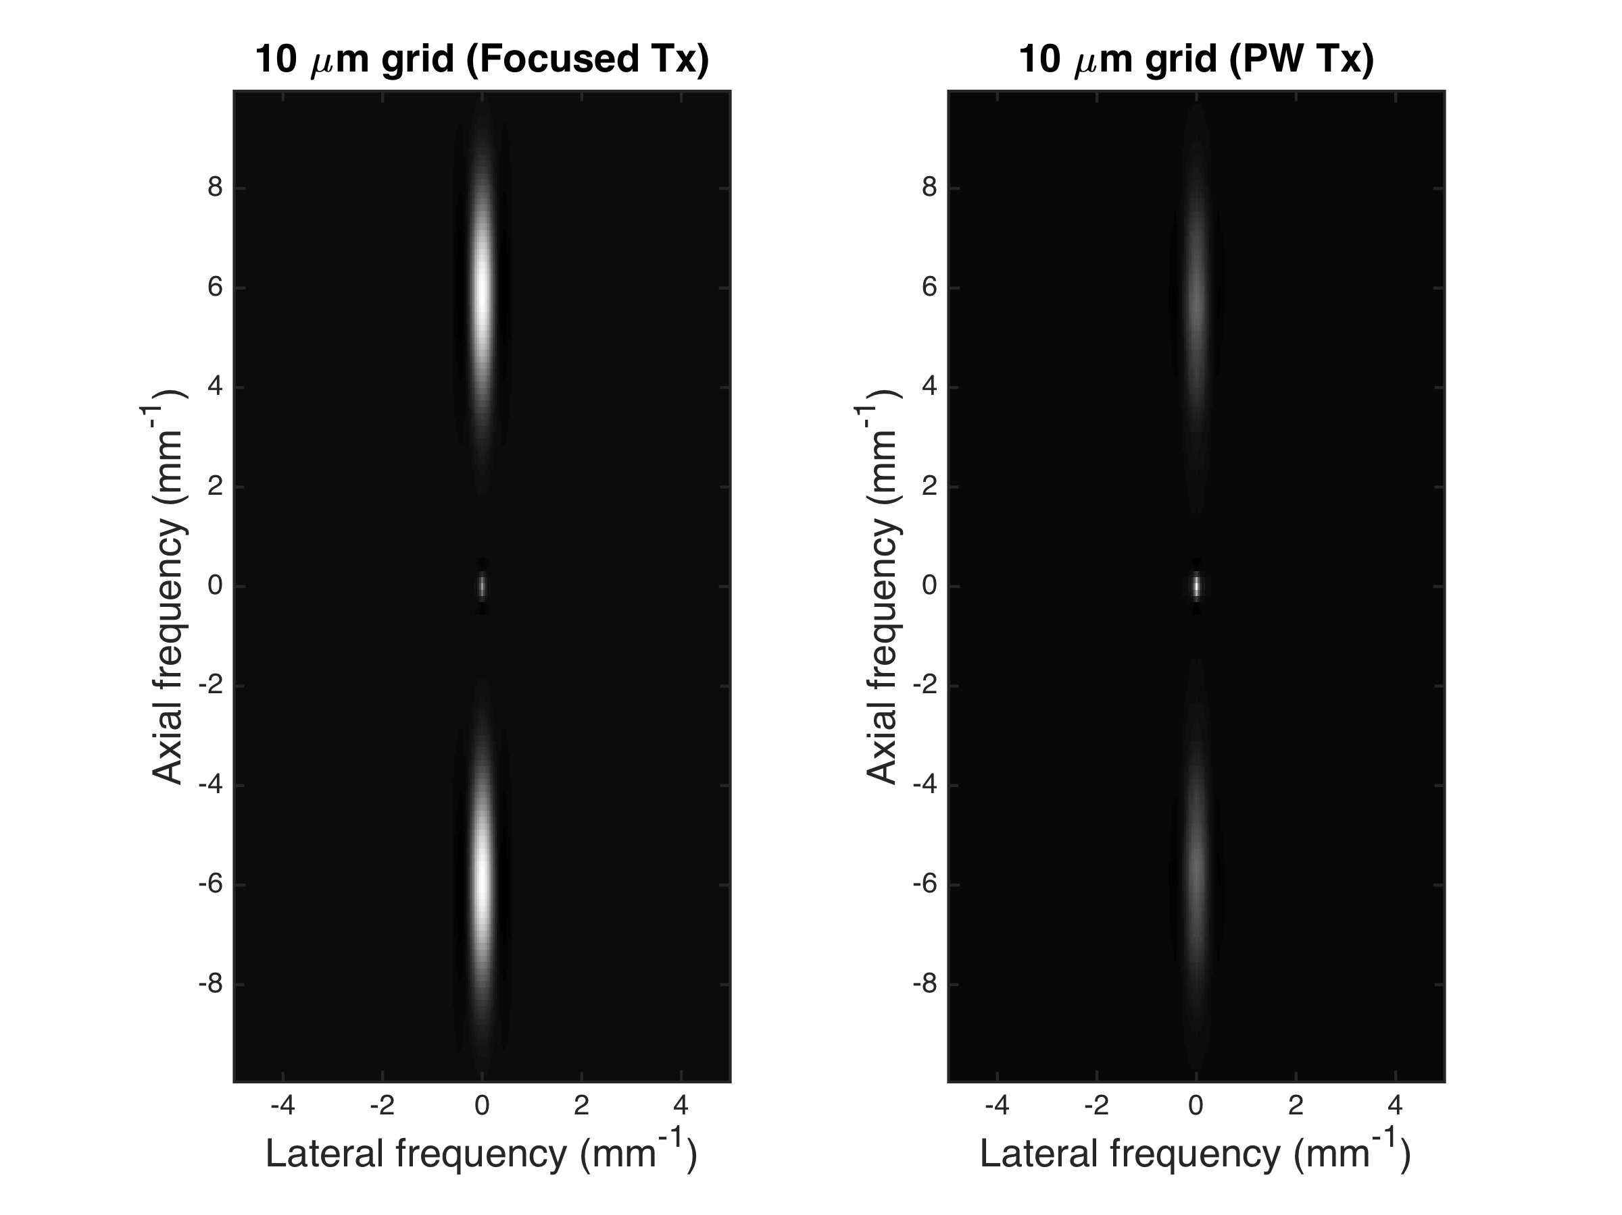
K-space of imaged 10 μm grid
Notes:
No recovery possible

Slide 12
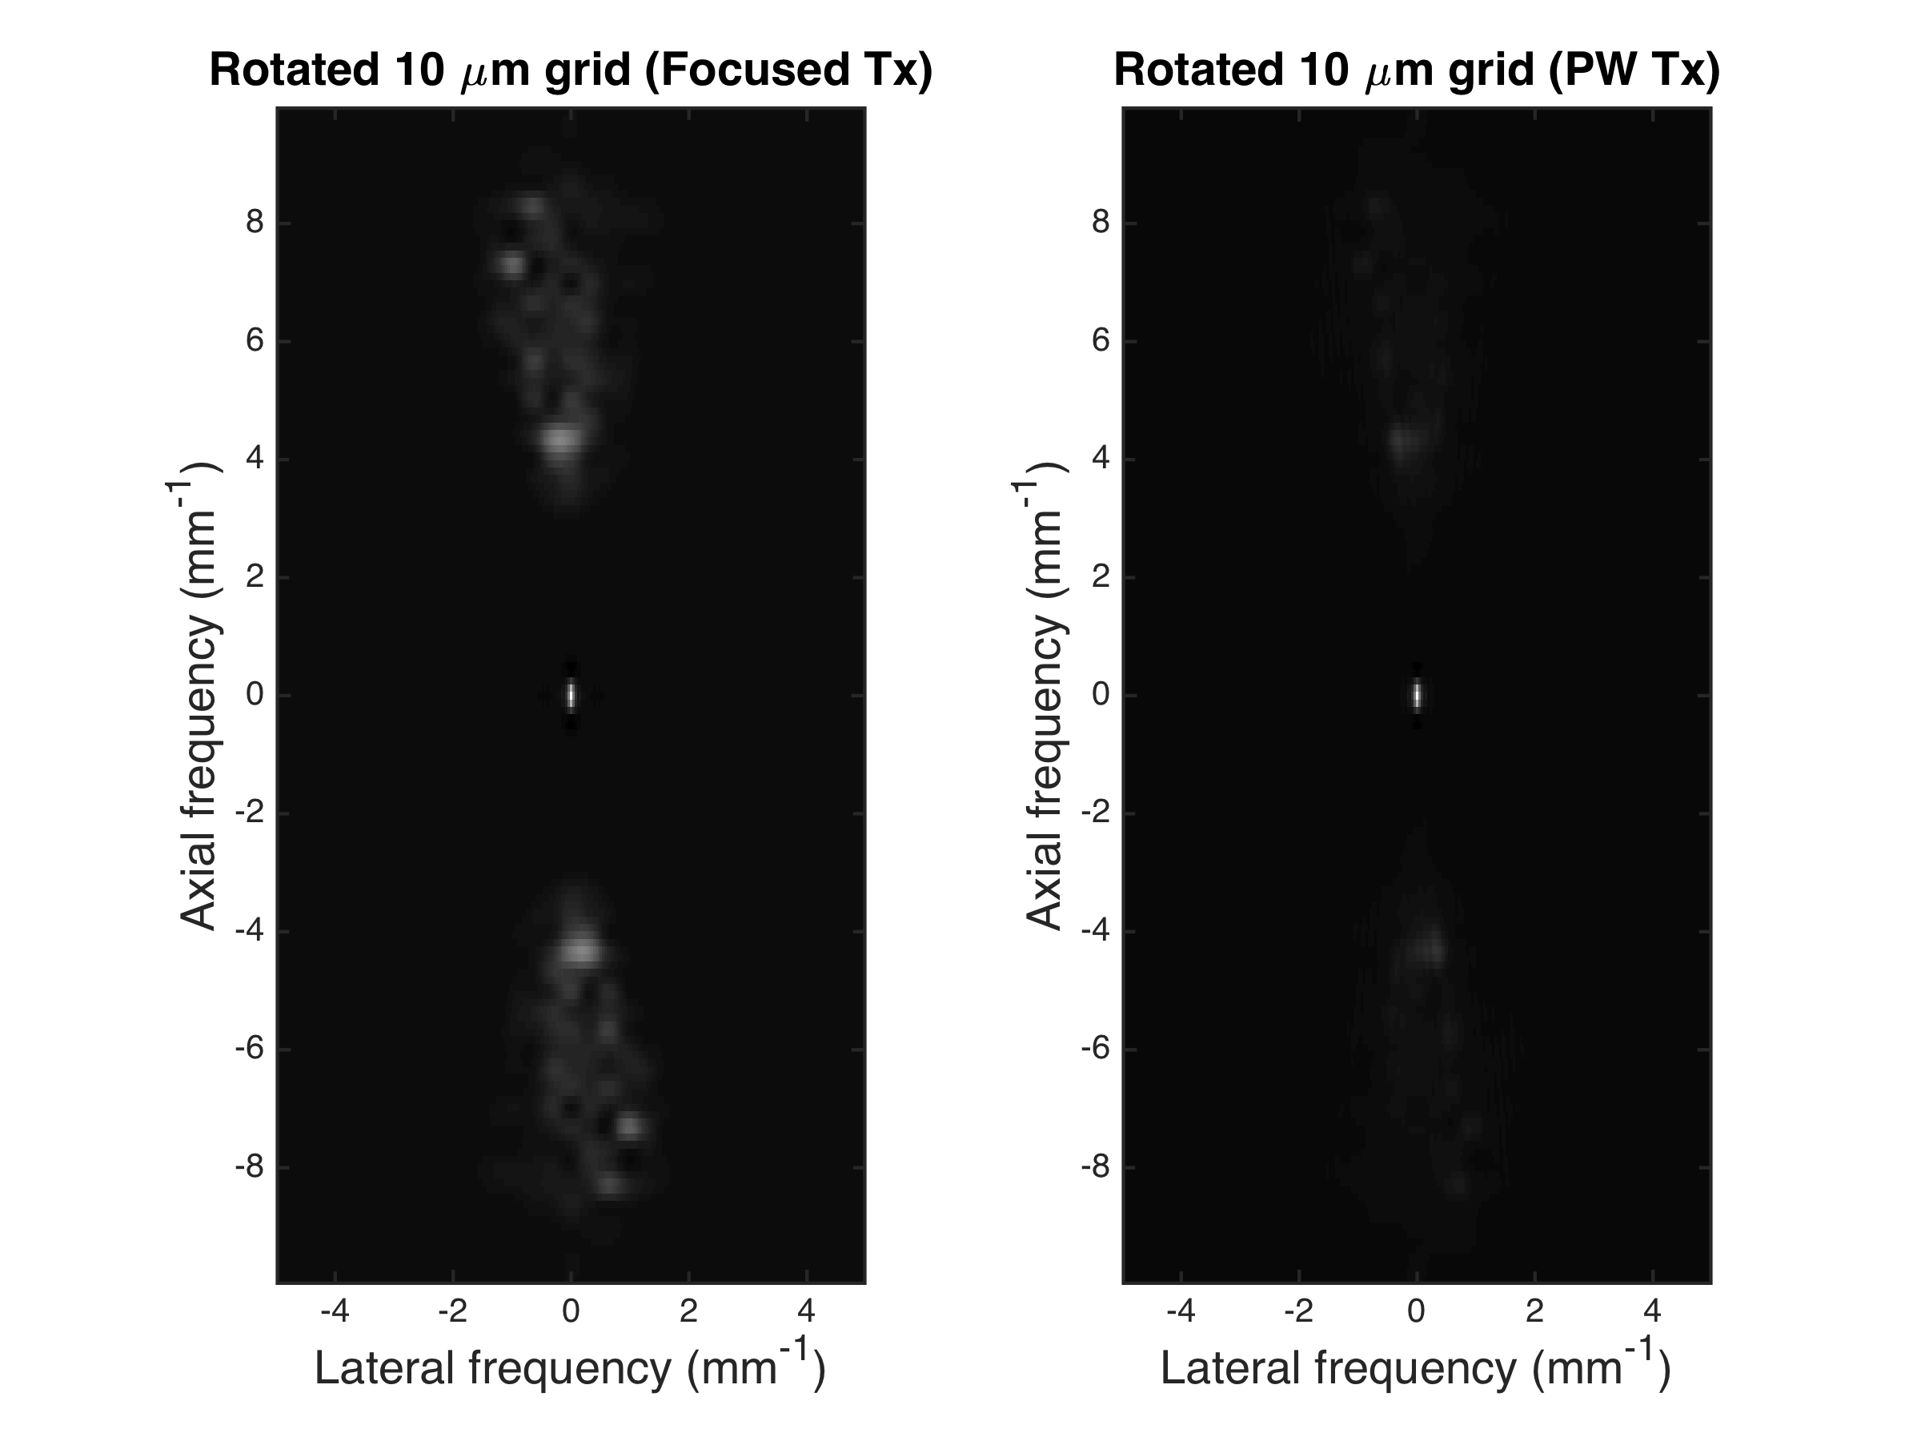
K-space of imaged 10 μm grid (rotated)

Slide 13
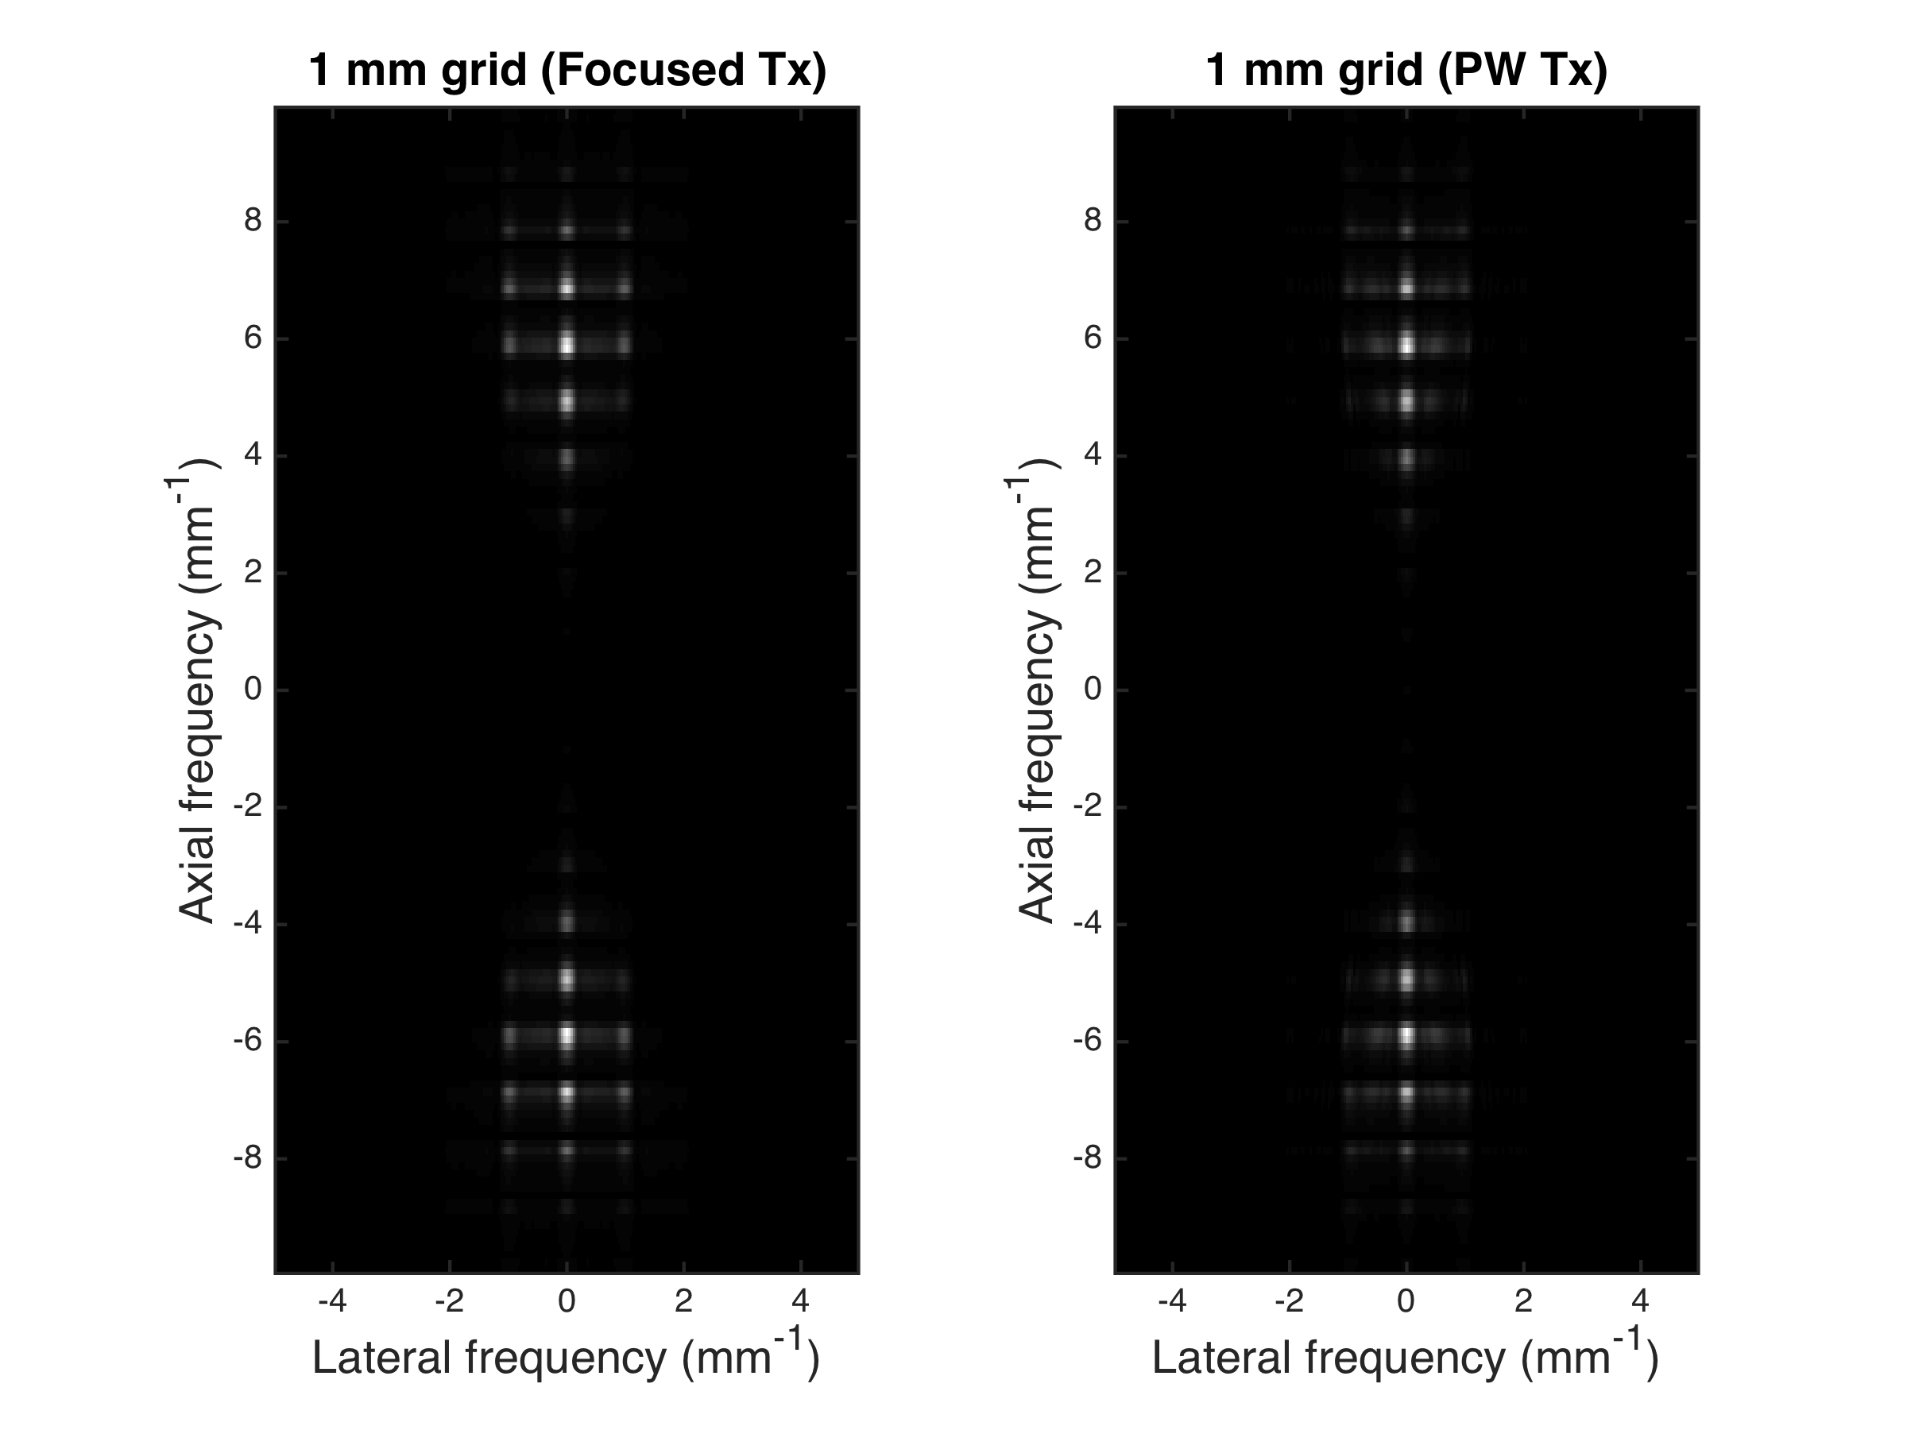
K-space of imaged 1 mm grid
Notes:
(cannot resolve point grid with > 2 mm-1 spacing) 0.5 mm grid (consistent with the lateral resolution)

Slide 14
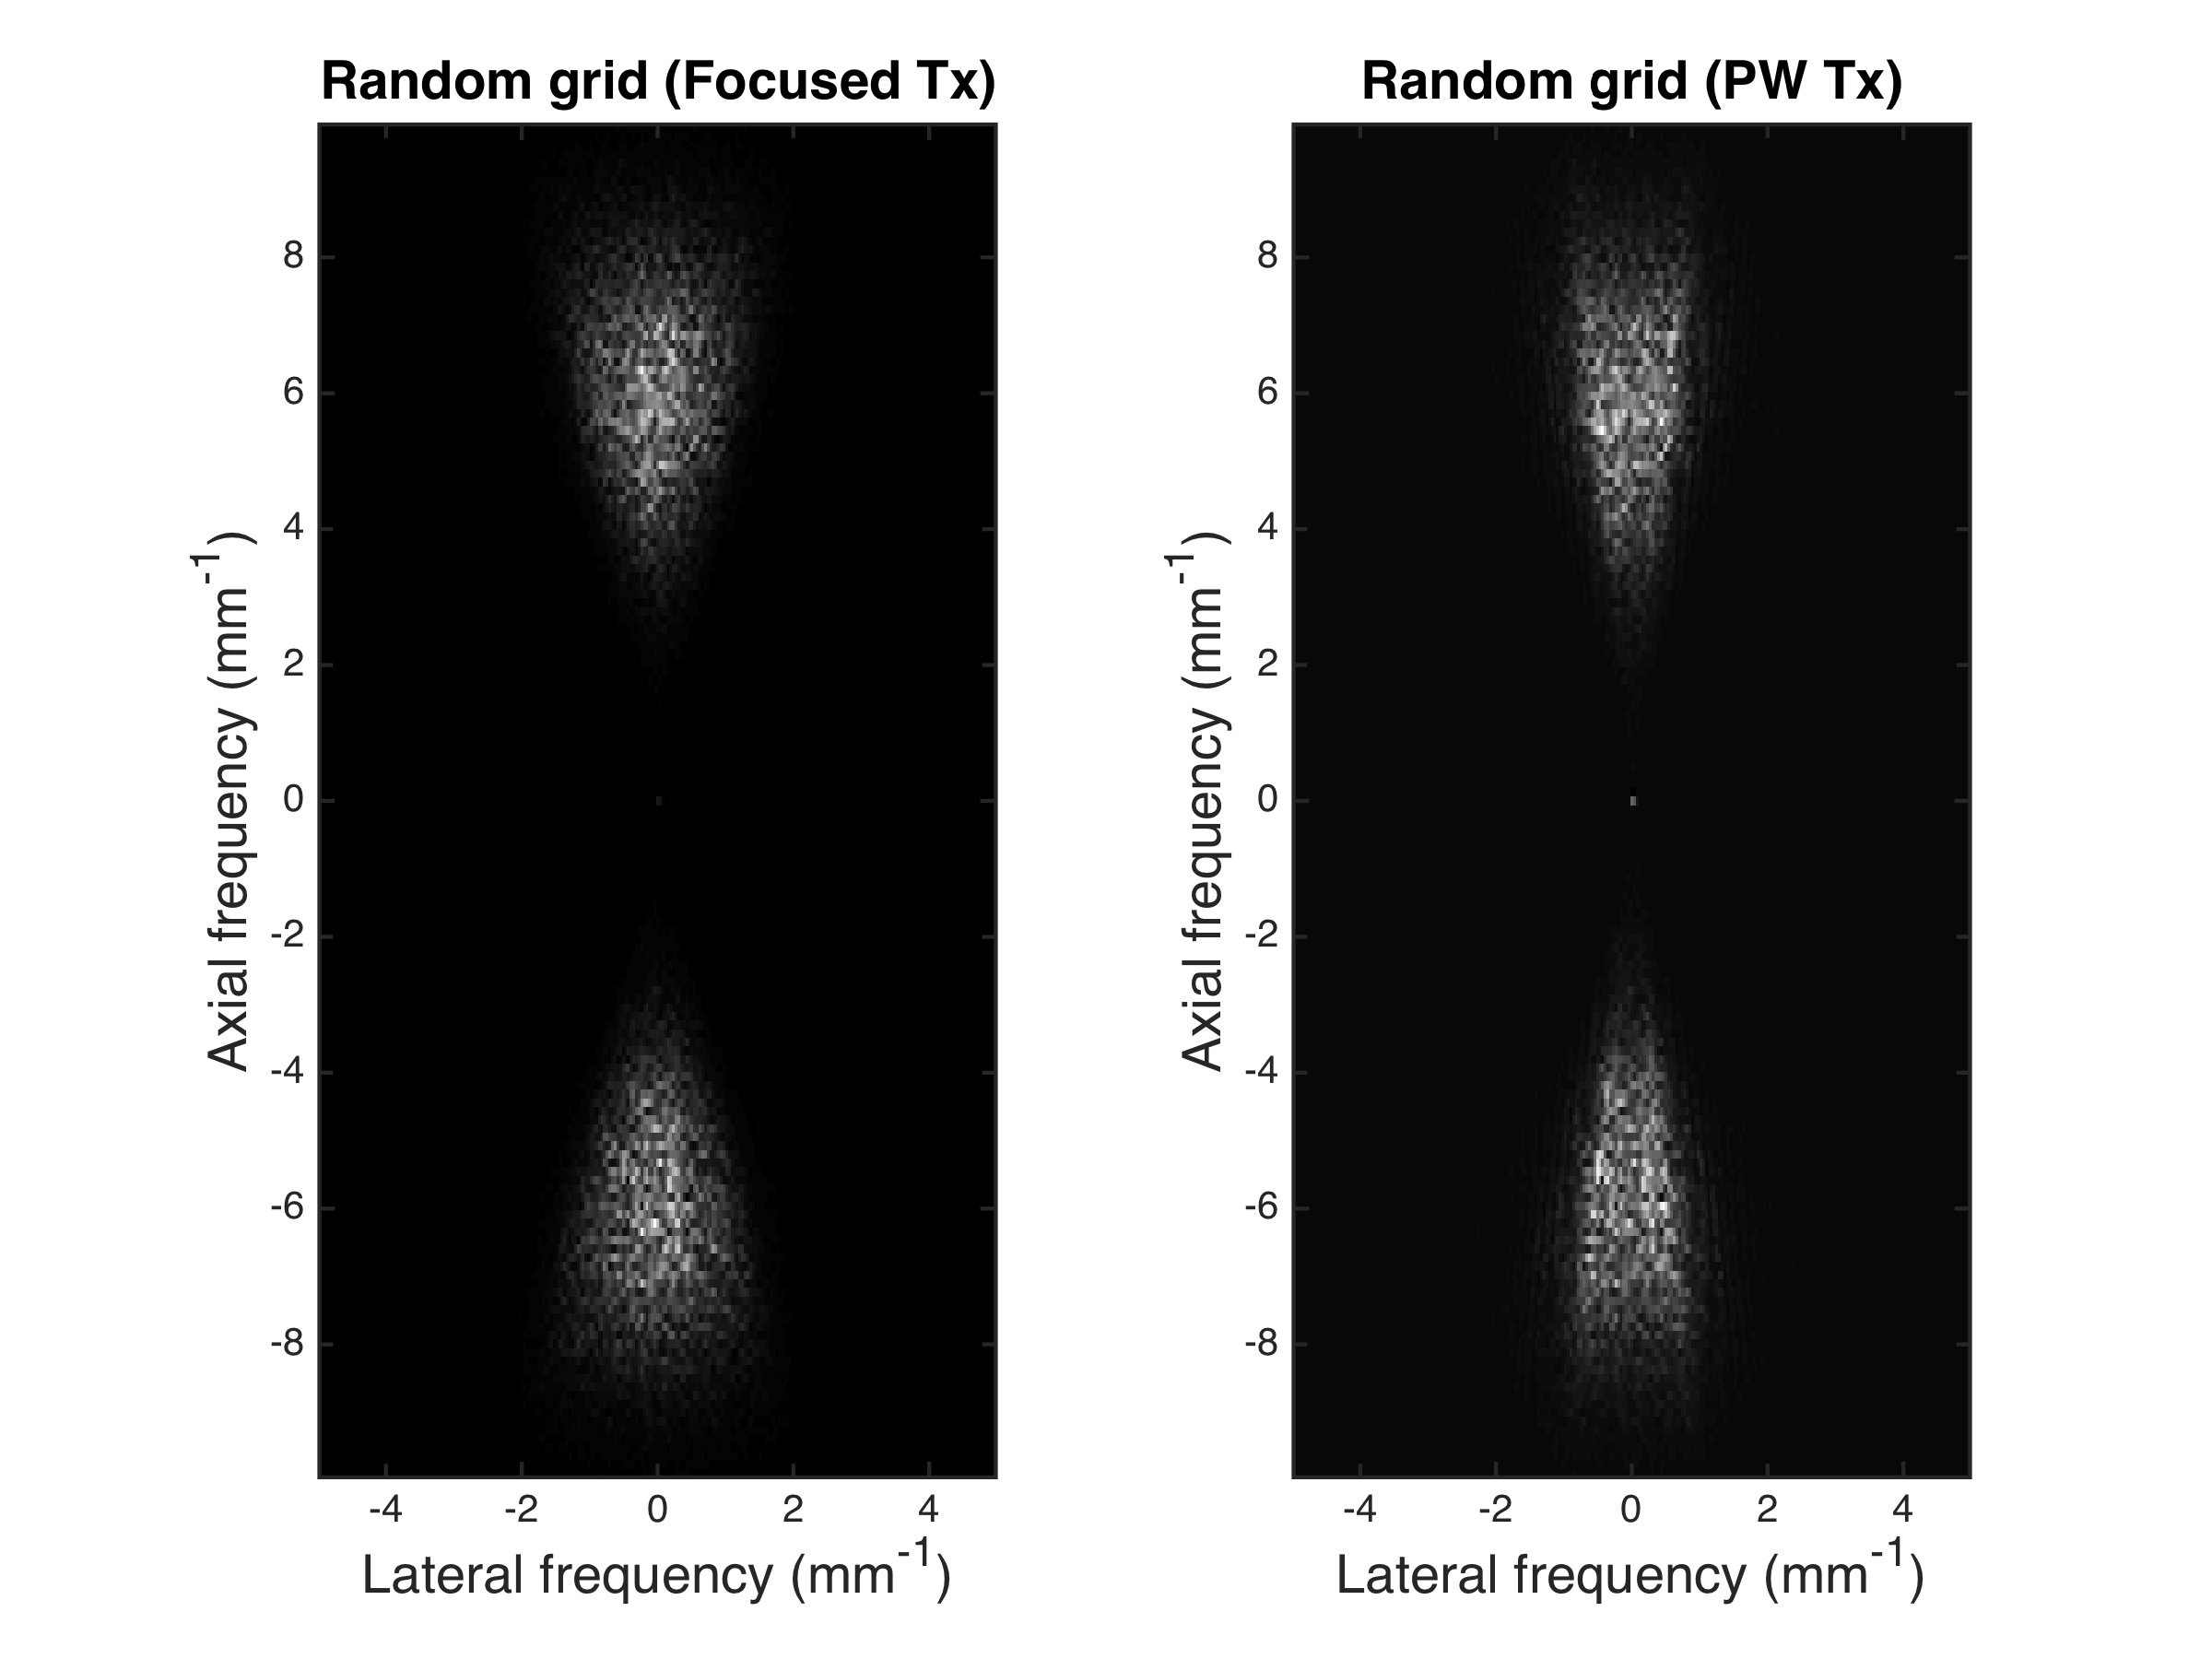
K-space of imaged random grid

